Slide 1

Intrusion Detection System
Using Machine Learning
Course Project | MA2201

Slide 2


Team Members:
Parepally Aravind
Gandham Suhas
Roll No: 2401MC36
Roll No: 2401MC18
Eesam Vishal Goud
Tunuguntla Hima Sai Chandana
Roll No: 2402MC01
Roll No: 2401MC37

Slide 3

Introduction:
An Intrusion Detection System is a security tool that monitors network traffic for suspicious activity and known threats. It acts as a digital security guard, analyzing data packets in real-time to identify patterns that deviate from "normal" behavior. The primary use of an IDS is to provide early warning alerts for cyberattacks before they can compromise sensitive data. As network traffic becomes more complex, traditional firewalls are often insufficient; an IDS provides a deeper layer of defense by using Machine Learning. Here are some challenges:
High-Dimensional Network Data
Evolving Cyber Attacks
Modern network traffic contains a large number of features (like packet size, protocol, duration), making it difficult to identify useful patterns using traditional methods.
Attackers constantly change their strategies (zero-day attacks, new malware), making rule-based systems ineffective and requiring adaptive ML-based detection.
Imablanced dataset Problem
Accurate MultiClass Classification
In datasets like the UNSW-NB15 dataset, normal traffic is much higher than attack traffic, which can lead to biased models if not handled properly.
The system must not only detect attacks but also correctly classify different types (DoS, Exploits, Fuzzers, etc.), which is a complex task.

Slide 4
Problem Statement:
Modern network environments face significant challenges in detecting cyber attacks due to the complexity and high dimensionality of network traffic data. Traditional detection systems struggle with imbalanced datasets, rapidly evolving attack patterns, and the need to accurately classify multiple types of intrusions. These limitations reduce detection effectiveness and highlight the need for more intelligent and adaptive solutions.

Slide 5

Project Objectives:
Four core objectives guide this project from raw data collection through to deployment of a fully functional predictive analytics solution.
Data Collection & Preprocessing
Model Development
Gather datasets, handle missing values, normalize features, and prepare data for training pipelines.
Design, train, and validate ML models using Random Forest, SVM, and Decision Trees.
Performance Evaluation
Deployment & Visualization
Measure accuracy, precision, recall, and F1-score to ensure reliable and robust predictions.
Deploy the model and build an interactive dashboard to present insights and predictions clearly.

Slide 6




Project Pipeline:
Data Collection
Feature Selection
Evaluation
Sourcing structured & unstructured datasets
Identifying most relevant predictive variables
K-Fold CV, confusion matrix, metrics
Preprocessing
Model Training
Cleaning, normalizing, encoding features
Algorithms
Algorithms Used
Tech Stack
Validation Strategy
Binary Class Classification-Random Forest, SVM, ,Decision Trees
Multi Class Classification –CadBoost , XGBoost , TabNet
Python · Scikit-learn · Pandas · NumPy · Matplotlib/Seaborn · Jupyter Notebook
Train-Test Split 60:40
Confusion Matrix Analysis

Slide 7
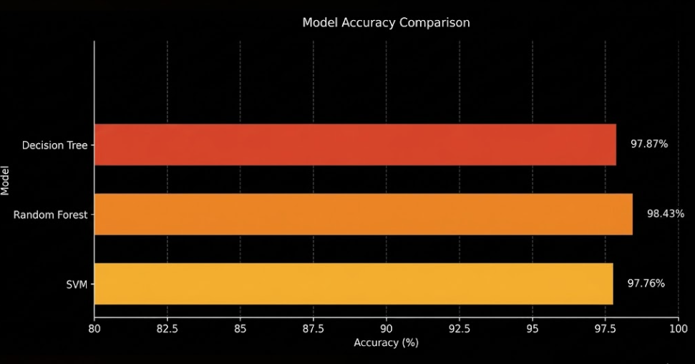



Model Evaluation:
98.4%
Binary Class Classification :
Best Model Accuracy
Random Forest → 98.43% Accuracy
Decision Tree → 97.87% Accuracy
SVM → 97.76% Accuracy
All models achieved high accuracy, with Random Forest performing best due to better generalization and reduced overfitting.
Binary Class Classification
Multi Class Classification :
Implemented advanced ensemble techniques using:
XGBoost
CatBoost
TabNet
These boosting-based models significantly improved the model’s ability to classify multiple attack categories by capturing complex patterns in network traffic.

Slide 8


Tools & Technologies:
A modern, industry-standard technology stack powering every stage — from data ingestion to model deployment and interactive visualization.
Language
ML Libraries
Data Tools
Python
Scikit-learn
Pandas
Stream lit
NumPy
Visualization
Environment
Dataset
Matplotlib
Jupyter Notebook
UNSW-NB15
Seaborn
VS Code
Google Colab

Slide 9
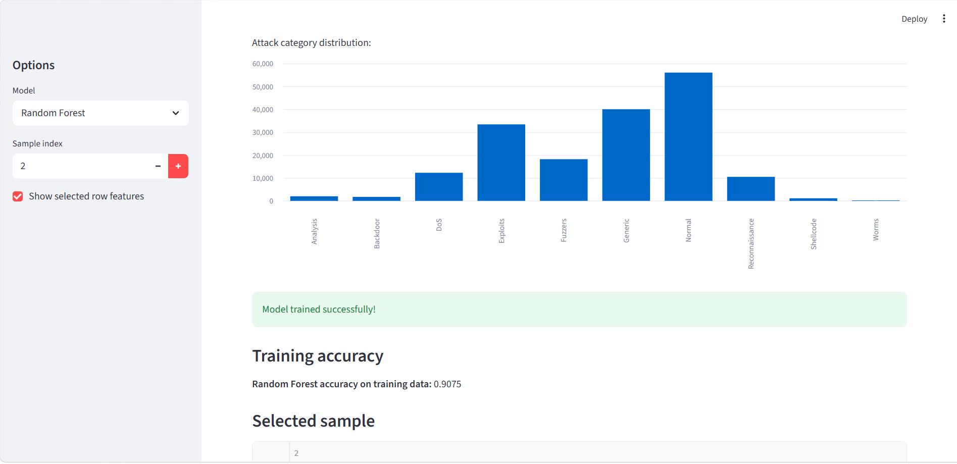
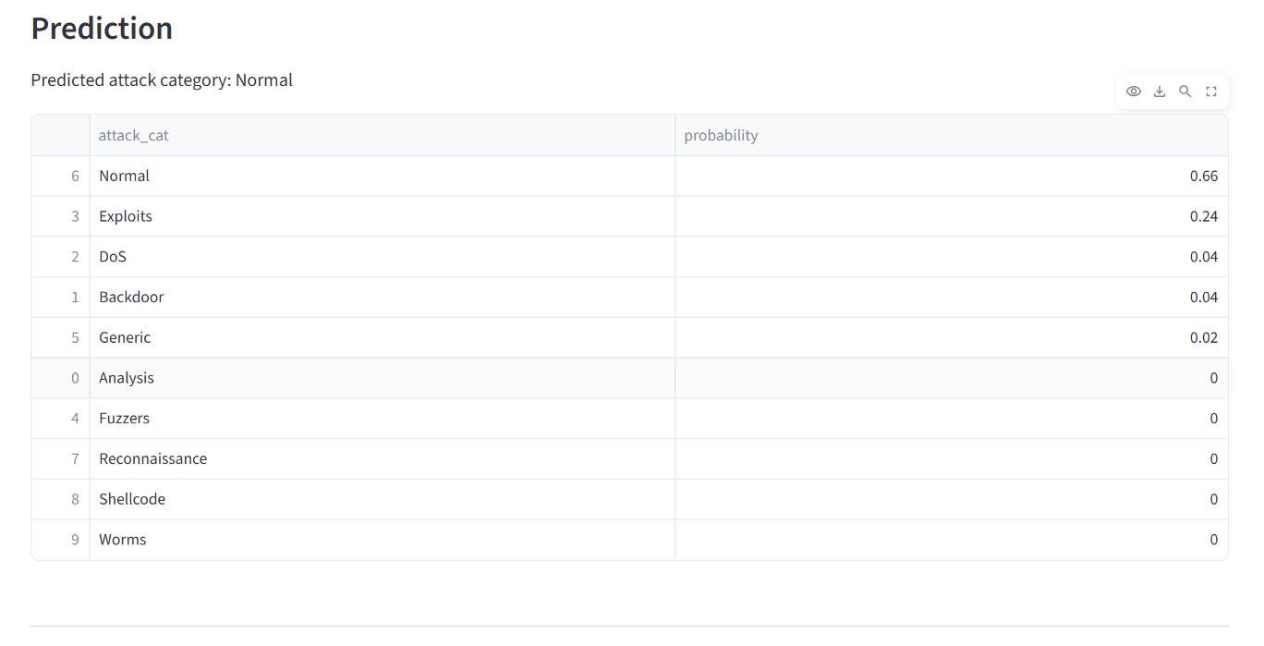
Intrusion Detection System Interface:
Developed an interactive frontend to visualize model predictions and performance
Users can select different machine learning models to analyze network traffic
Displays model accuracy along with prediction results

Slide 10

Conclusion & Future Scope:
Conclusion
Future Scope
Achieved 98.4% accuracy — a strong benchmark for real-world ML deployment.
Real-Time Detection — analyze live network traffic instead of only the UNSW-NB15 dataset to detect attacks instantly.
System Integration — connect the IDS with firewalls or alert systems to automatically respond to threats.
Advanced Deep Learning Models — use models like LSTM or neural networks to improve accuracy and detect complex patterns.
Zero-Day Attack Detection — enhance anomaly detection techniques to identify new and unseen attacks.
Web-Based Dashboard — develop a user interface to monitor network activity and attack alerts in real time.
Random Forest outperformed all other algorithms tested in this project.
Demonstrated that ML can classify complex network attacks from large datasets.
ML predictions proven significantly more reliable than traditional methods.

Slide 11


Thank you

